Slide 1


LOAD SHORTFALL PREDICTIONAT 3-HOURLY FREQUENCY FOR SPAIN
THE FANTASTIC 5 DATA SCIENCE TEAM

Slide 2
Our Mission
Our Vision
Our Services
Our Values
ABOUT US
To become a leading data-driven sustainable solutions provider
To promote a data-centric approach to problem solving in Africa through the provision of innovative data-driven solutions and training
We help organizations achieve more with their data in real-time and train teams to stay agile.
Excellence, Integrity, Collaboration, Respect and Client-centric Services

Slide 3





OUR TEAM
Nnamdi Isichei
Michael Okereafor
Meleka Victor
Lead Technical Adviser
Machine Learning Specialist
Model Specialist
Solomon Nwokoro
Oke Ifedapo John
Lead Statistician
Lead Research Scientist

Slide 4
OUR TEAM
Nnamdi Isichei
Michael Okereafor
Meleka Victor
Lead Technical Adviser
Machine Learning Specialist
Model Specialist
Solomon Nwokoro
Oke Ifedapo John
Lead Statistician
Lead Statistician

Slide 5
OUR TEAM
Nnamdi Isichei
Michael Okereafor
Meleka Victor
Lead Technical Adviser
Machine Learning Specialist
Model Specialist
Solomon Nwokoro
Oke Ifedapo John
Lead Statistician
Lead Statistician

Slide 6
OUR TEAM
Nnamdi Isichei
Michael Okereafor
Meleka Victor
Lead Technical Adviser
Machine Learning Specialist
Model Specialist
Solomon Nwokoro
Oke Ifedapo John
Lead Statistician
Lead Statistician

Slide 7
OUR TEAM
Nnamdi Isichei
Michael Okereafor
Meleka Victor
Lead Technical Adviser
Machine Learning Specialist
Model Specialist
Solomon Nwokoro
Oke Ifedapo John
Lead Statistician
Lead Statistician

Slide 8
OUR TEAM
Nnamdi Isichei
Michael Okereafor
Meleka Victor
Lead Technical Adviser
Machine Learning Specialist
Model Specialist
Solomon Nwokoro
Oke Ifedapo John
Lead Statistician
Lead Statistician

Slide 9
ORDER OF PRESENTATION
01.
02.
03.
04.
Introduction
Problem Statement
Problem presented through storyline
We identified the problem to be solved
Data Presentation
Data Exploration
We shall discuss about the data and data analysis
Here, we’ll discuss the process of Exploratory Data Analysis
Model Presentation
05.
06.
Conclusion
Present the models deployed for predictions
Conclusion and recommendation will be given here

Slide 10
ORDER OF PRESENTATION
01.
02.
03.
04.
Introduction
Problem Statement
Problem presented through storyline
We identified the problem to be solved
Data Presentation
Data Exploration
We shall discuss about the data and data analysis
Here, we’ll discuss the process of Exploratory Data Analysis
Model Presentation
05.
06.
Conclusion
Present the models deployed for predictions
Conclusion and recommendation will be given here

Slide 11
ORDER OF PRESENTATION
01.
02.
03.
04.
Introduction
Problem Statement
Problem presented through storyline
We identified the problem to be solved
Data Presentation
Data Exploration
We shall discuss about the data and data analysis
Here, we’ll discuss the process of Exploratory Data Analysis
Model Presentation
05.
06.
Conclusion
Present the models deployed for predictions
Conclusion and recommendation will be given here

Slide 12
ORDER OF PRESENTATION
01.
02.
03.
04.
Introduction
Problem Statement
Problem presented through storyline
We identified the problem to be solved
Data Presentation
Data Exploration
We shall discuss about the data and data analysis
Here, we’ll discuss the process of Exploratory Data Analysis
Model Presentation
05.
06.
Conclusion
Present the models deployed for predictions
Conclusion and recommendation will be given here

Slide 13
ORDER OF PRESENTATION
01.
02.
03.
04.
Introduction
Problem Statement
Problem presented through storyline
We identified the problem to be solved
Data Presentation
Data Exploration
We shall discuss about the data and data analysis
Here, we’ll discuss the process of Exploratory Data Analysis
Model Presentation
05.
06.
Conclusion
Present the models deployed for predictions
Conclusion and recommendation will be given here

Slide 14
ORDER OF PRESENTATION
01.
02.
03.
04.
Introduction
Problem Statement
Problem presented through storyline
We identified the problem to be solved
Data Presentation
Data Exploration
We shall discuss about the data and data analysis
Here, we’ll discuss the process of Exploratory Data Analysis
Model Presentation
05.
06.
Conclusion
Present the models deployed for predictions
Conclusion and recommendation will be given here

Slide 15
ORDER OF PRESENTATION
01.
02.
03.
04.
Introduction
Problem Statement
Problem presented through storyline
We identified the problem to be solved
Data Presentation
Data Exploration
We shall discuss about the data and data analysis
Here, we’ll discuss the process of Exploratory Data Analysis
Model Presentation
05.
06.
Conclusion
Present the models deployed for predictions
Conclusion and recommendation will be given here

Slide 16

01. Introduction
Imagine a world without electricity…

Slide 17


Slide 18

02.
Problem Statement
The problem statement is identified as follows:

Slide 19
Problem Statement
Following evidence that the primary reliance of non-renewable resources is not sustainable, the Spanish government seeks to increase her investments in renewable energy resource infrastructure. This means gathering information about the country’s fossil fuel and renewable sources, trends and patterns. In that regard, the Fantastic5 Data science team plans to model the shortfall between fossil fuel energy and other renewable energy sources in Spain.

Slide 20
03. Data Presentation
To avoid such a problem in Spain, the government gathered data on weather conditions in five Spanish cities from 2015 to 2017 which also includes statistics on three hourly load shortfall over the same time period.

Slide 21
Data Presentation
2015
2016
2017
01
02
03
3 hourly Load Shortfall
35,233,437 MWH
30,280,324 MWH
28,021,253 MWH

Slide 22
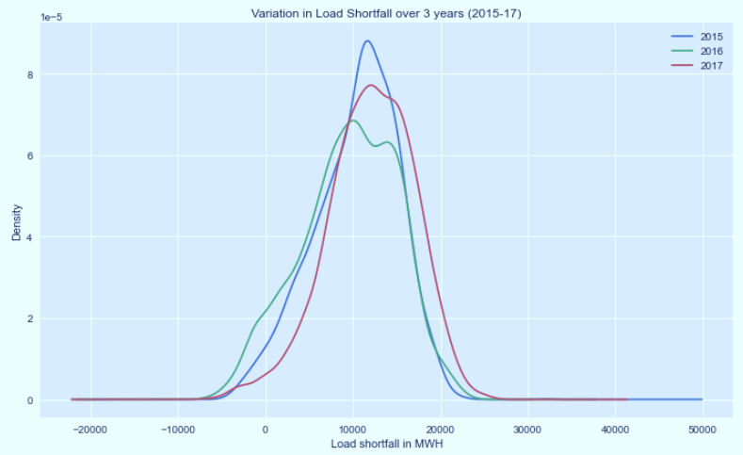
Density plot of load shortfall

Slide 23
Target variable
Load shortfall 3h
Load shortfall
Time

Slide 24
Features
Cloud all
Rain
Wind
Humidity
Snow
Temperature
Pressure

Slide 25
Features
Cloud all
Rain
Wind
Humidity
Snow
Temperature
Pressure

Slide 26
Features
Cloud all
Rain
Wind
Humidity
Snow
Temperature
Pressure

Slide 27
Features
Cloud all
Rain
Wind
Humidity
Snow
Temperature
Pressure

Slide 28
Features
Cloud all
Rain
Wind
Humidity
Snow
Temperature
Pressure

Slide 29
Features
Cloud all
Rain
Wind
Humidity
Snow
Temperature
Pressure

Slide 30
Features
Cloud all
Rain
Wind
Humidity
Snow
Temperature
Pressure

Slide 31
Features
Cloud all
Rain
Wind
Humidity
Snow
Temperature
Pressure

Slide 32
Process flowchat
Importing data
3-Hourly energy data
Data /cleaning/wrangling
Adding features
EDA
Preparing data for ML models, Feature engineering, define error metrics
ML models training & testing and comparing results

Slide 33
04. Data Exploration (EDA)

Slide 34

Load shortfall Data
Bercelona
Spain
3 hourly load shortfall
Madrid
Bilbao
Valencia
Seville

Slide 35
Data Cleaning
Data imported
Data cleaning and formatting
Filling null values
Notes:
-Data imported and stored in pandas DataFrame
- Data cleaning and formatting done with the help of data visualization and Descriptive stats.
-The null values were filled with the average values of the matching year, month and weekday for the same hours from the rest of the data.

Slide 36
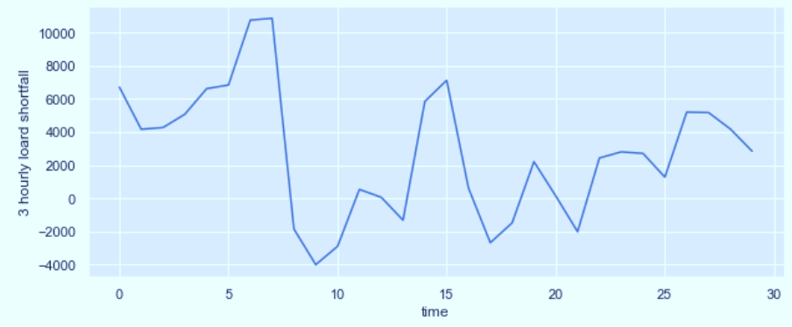
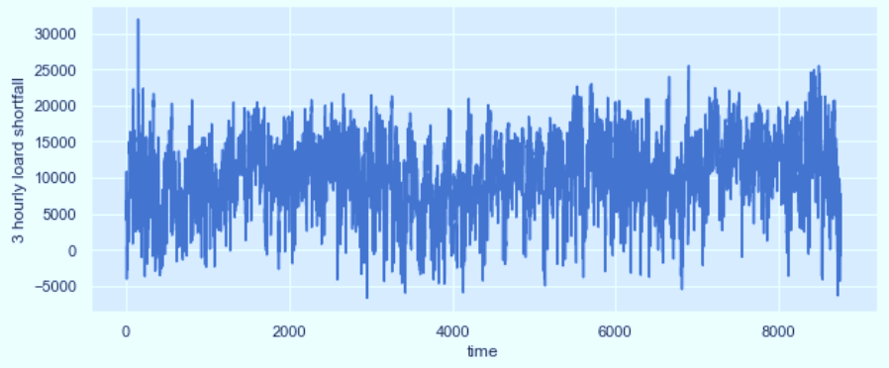
Load shortfall varies with time
91,998 hours of data
Load shortfall measured in MWH
Mean: 10,673.86
Median: 11,114.67
Min: -6,618.00
Max: 31,904.00

Slide 37
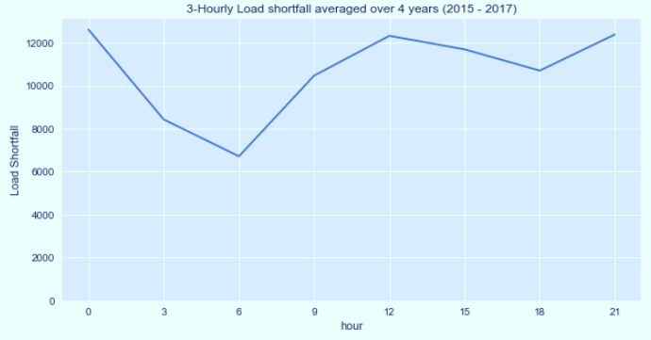
3 Hourly Variation of Load Shortfall

Slide 38
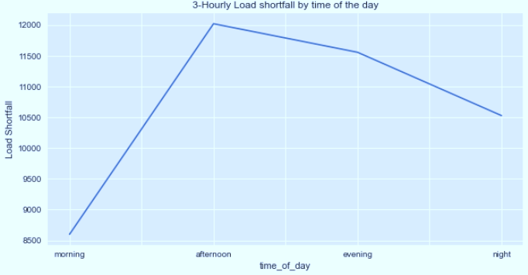
Variation by time of day

Slide 39
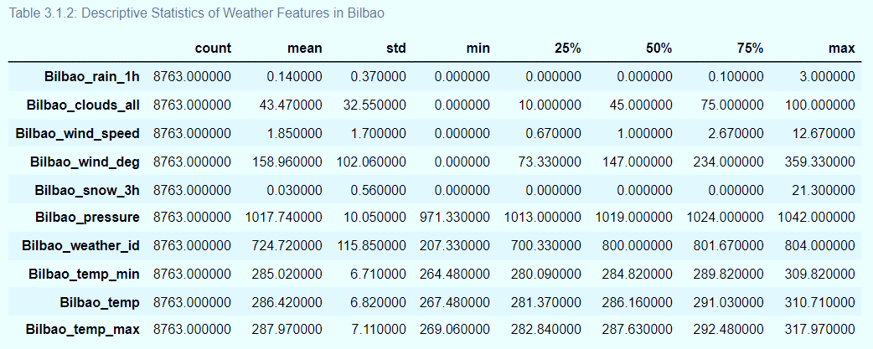
Grouping weather features by cities

Slide 40
Cities with similar weather features
S/N | Cities | Similar features
1. | Barcelona, Bilbao, Madrid, Seville, Valencia | wind_speed, temp
2. | Barcelona, Bilbao, Madrid, Valencia | pressure
3. | Madrid, Seville, Valencia | humidity
4. | Bilbao, Madrid, Seville | clouds_all
5. | Barcelona, Bilbao, Madrid, Seville | rain_1h
6. | Barcelona, Seville | rain_3h
7. | Bilbao, Valencia | snow_3h

Slide 41
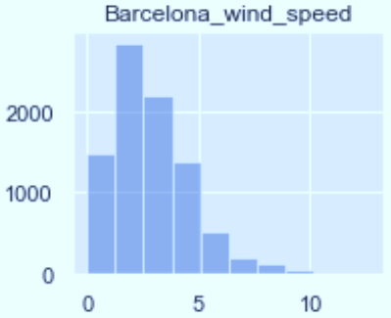
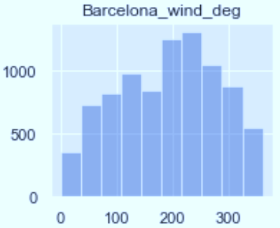
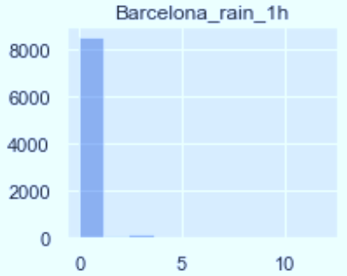
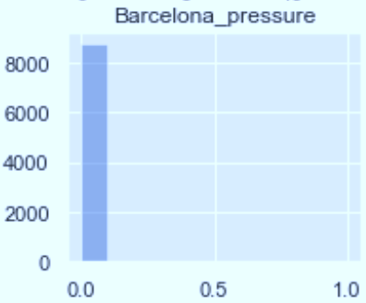
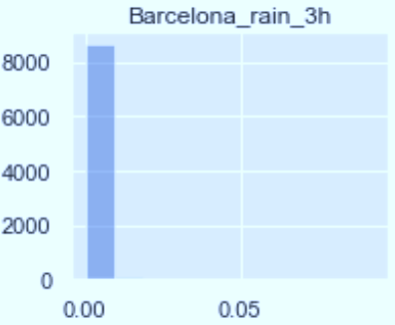
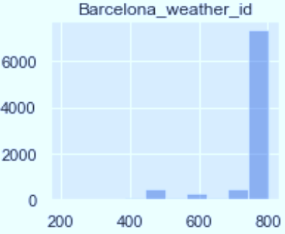
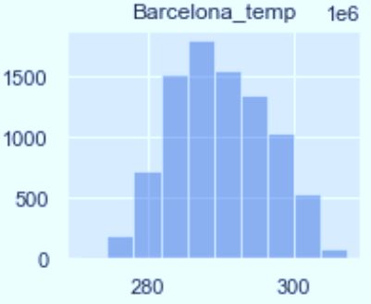

Hypothesis 1
$H_{0}$: There is no relationship in the trend between the weather features from various cities.

Slide 42
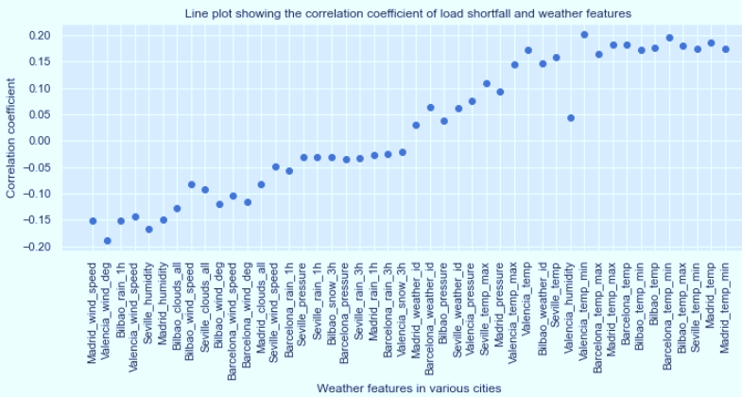

Hypothesis 2
$H_{0}$: There is no relationship between the target variable (load shortfall) and the predictors.

Slide 43
Data cleaning and feature Engineering

Slide 44
Data cleaning/engineering proceedure
Missing values in Valencia pressure was replaced with mean()
Convert time feature with object datatype to numeric datatype
Breaking down the time feature in to different features such as Year, Month, Day etc
Removing unnecessary column(s)
Removing correlated column(s)
Removing outliers for some features(Scaling)

Slide 45

05. Model Presentation

Slide 46
Load shortfall 3h
Why time series?
Our target variable is a time series data hence requires some time series model.
It’s time series because it’s a sequence of observations taken sequentially in time with the following components:
Trend
Seasonality
Irregularity

Slide 47
Load shortfall 3h
Why time series?
Our target variable is a time series data hence requires some time series model.
It’s time series because it’s a sequence of observations taken sequentially in time with the following components:
Trend
Seasonality
Irregularity

Slide 48
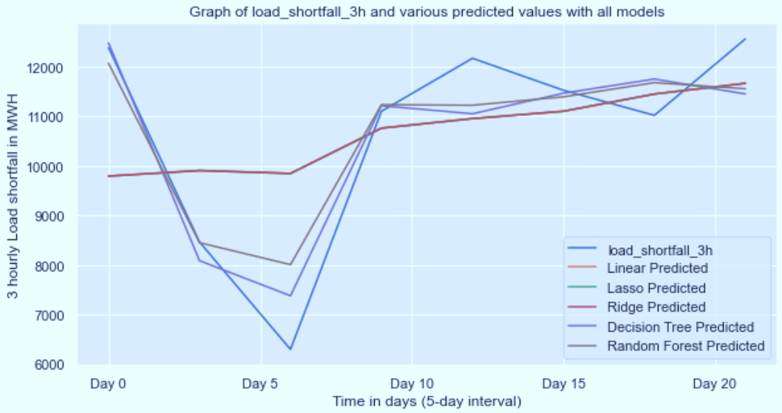
Model Exploration

Slide 49
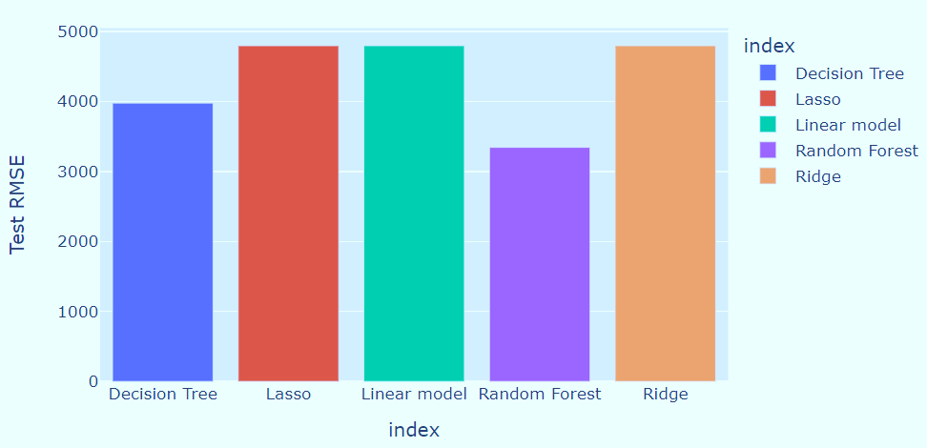
Model Performance – RMSE Test

Slide 50
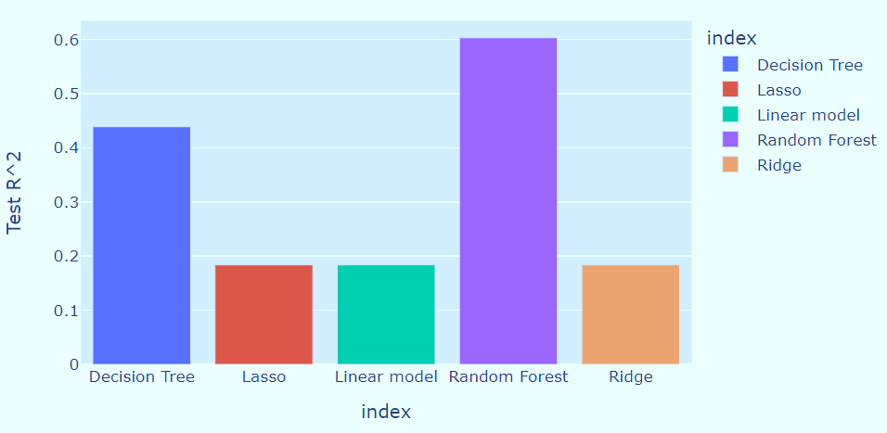
Model Performance – $R^{2}$ Score

Slide 51
06. Conclusion and Recommendation

Slide 52
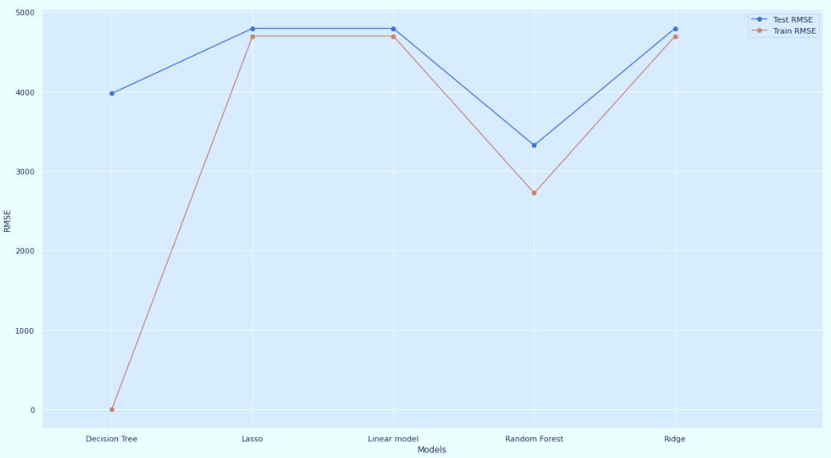
Model Performance – $R^{2}$ Score

Slide 53

Therefore, the Random forest model emerged to be the best model with a $R^{2}$ of 0.60 which tells us that 60% proportion of load shortfall can be directly attributed to the renewable sources variables.
Conclusion
Recommendation
The use of purely non-renewable sources is therefore sustainable hence the government of Spain can consider expanding its investment in the renewable energy resource infrastructure.
Notes:
In conclusion, We have successfully modeled the Spain electricity load shortfall (which is the difference in energy generated by fossil fuels and renewable sources) as a function of various city-specific weather features. The Random forest emerged to be the best model with a R^2 of 0.60 which tells us that 60% proportion of load shortfall can be directly attributed to the renewable sources variables. The use of purely non-renewable sources is therefore sustainable hence the government of Spain can consider expanding its investment in the renewable energy resource infrastructure.

Slide 54

THANKS
Do you have any questions?
info@fantastic5consult.com
+91 620 421 88
www.fantastic5constult.com
Please keep this slide for attribution

